Slide 1
caArray User Interface Review
2.0 Wireframe Discussion
September 17, 2007

Slide 2
Agenda
Process Overview
  How we work
  Upcoming Schedule
Review Where We Are Now
  Navigation, Search and User Management (Login)
  Data Management
  Experiment Management
  Extraction

Slide 3
Process Overview
We begin with Use Cases in narrative form
  Acquire feedback on the narratives
Translate the narratives to Wireframes
  Produce them as jpgs in black and white to focus on function not style
  Incorporate feedback
Produce HTML templates from the finalized Wireframes
Integrate them into the code base
  Promote use of Style Sheets vs. images wherever possible and supportable javascript vs. flash

Slide 4
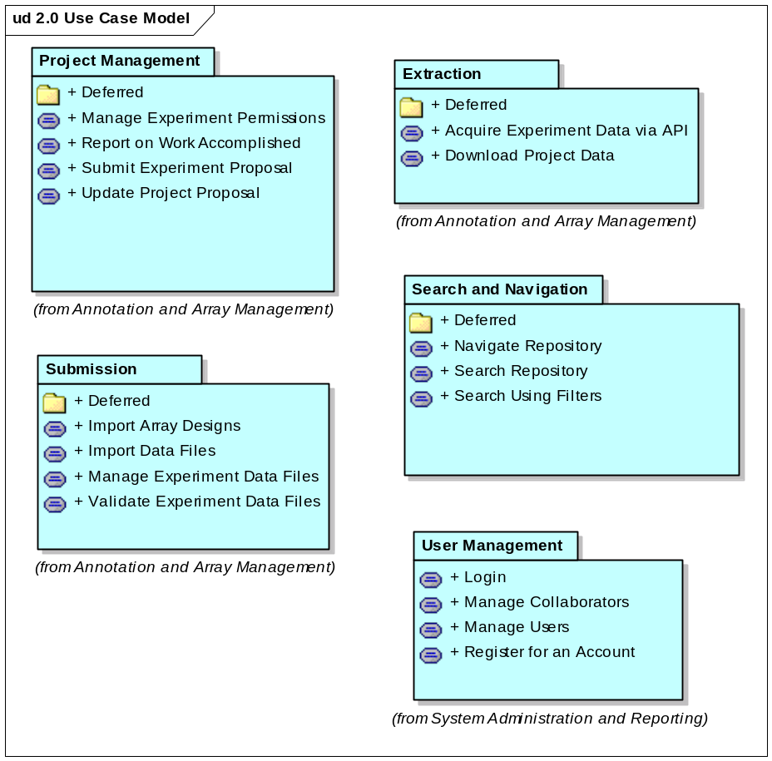
What We’ll Cover Today

Slide 5
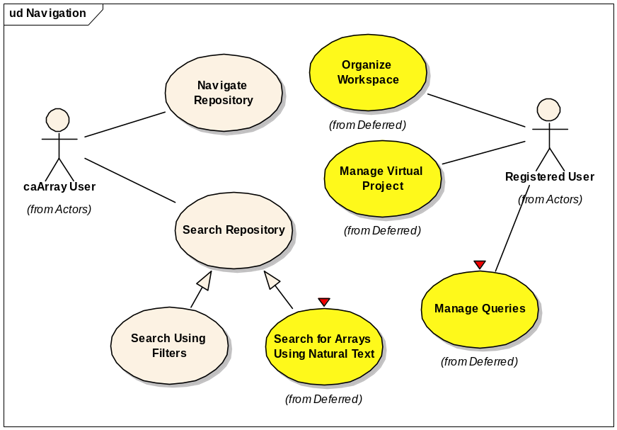
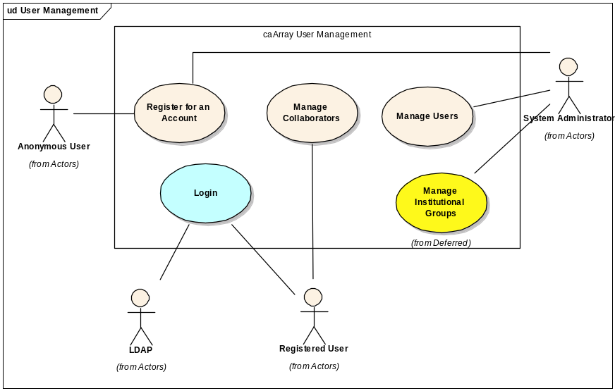
Navigation and Search

Slide 6
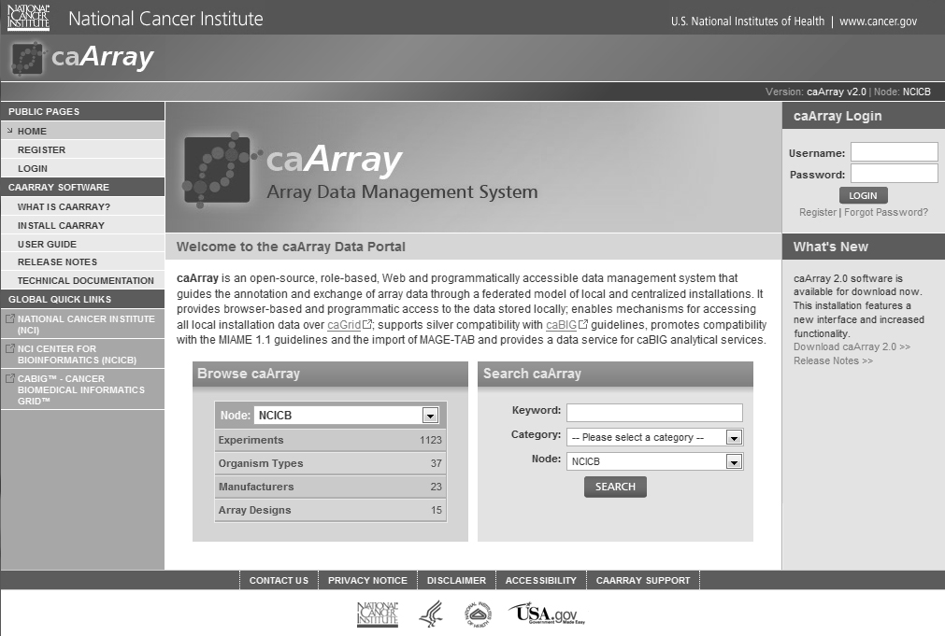
Navigate Repository
3
1
2
Notes:
Represents the home page and navigational orientation
Menus are role dependent but able to represent multiple role actions
Availab

Slide 7
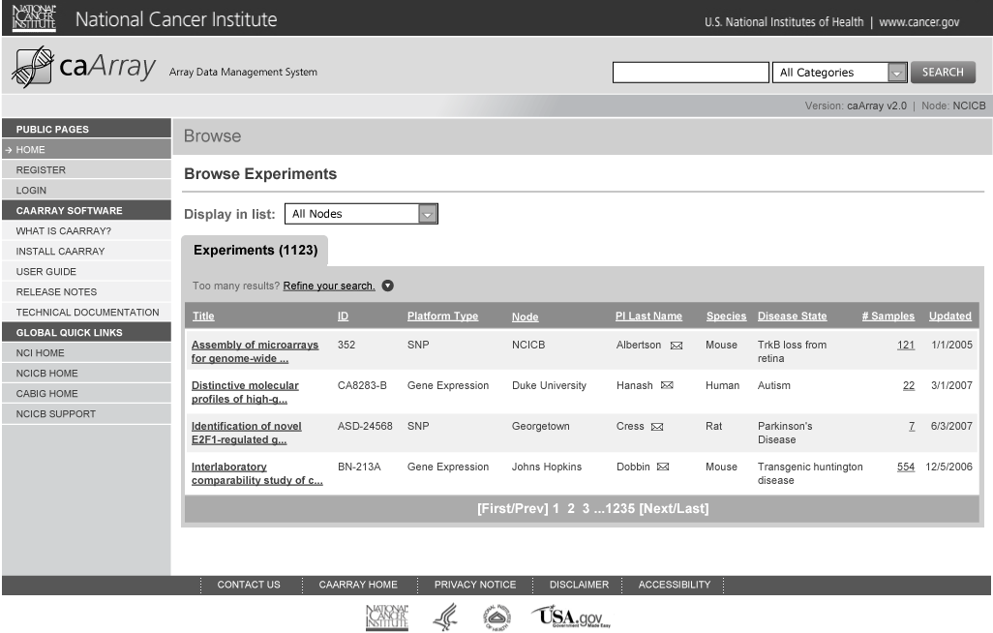
Browse by Category and Results

Slide 8
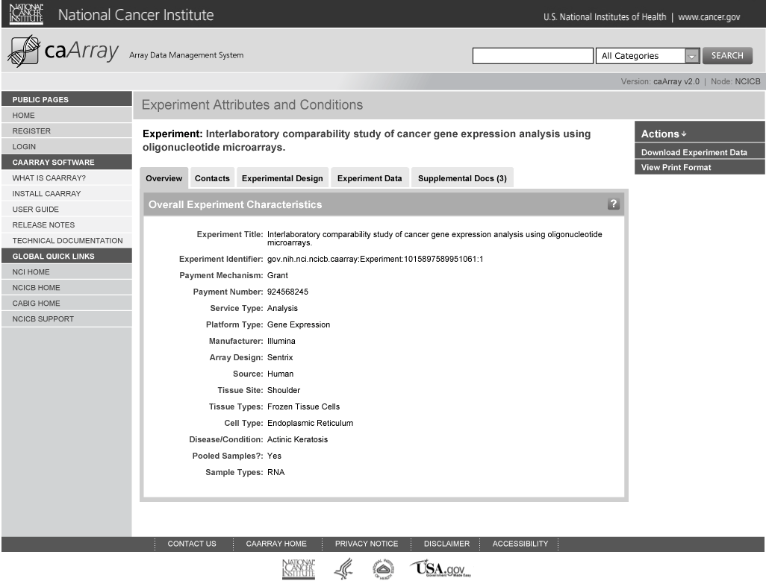
View Experiment Details

Slide 9
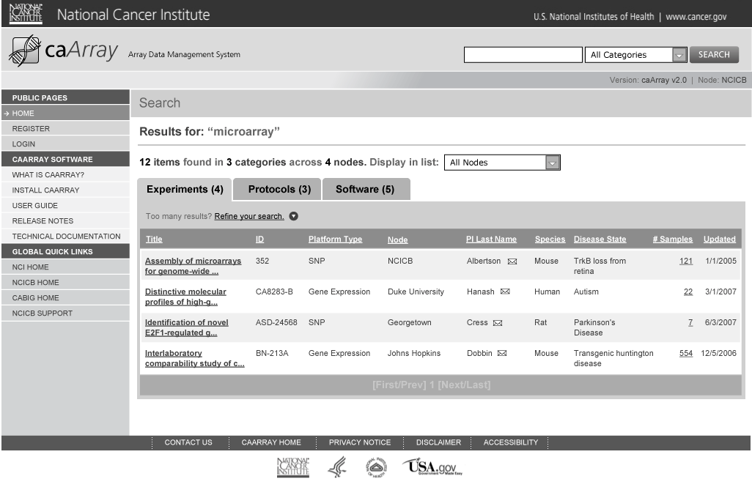
Search and Search Results

Slide 10
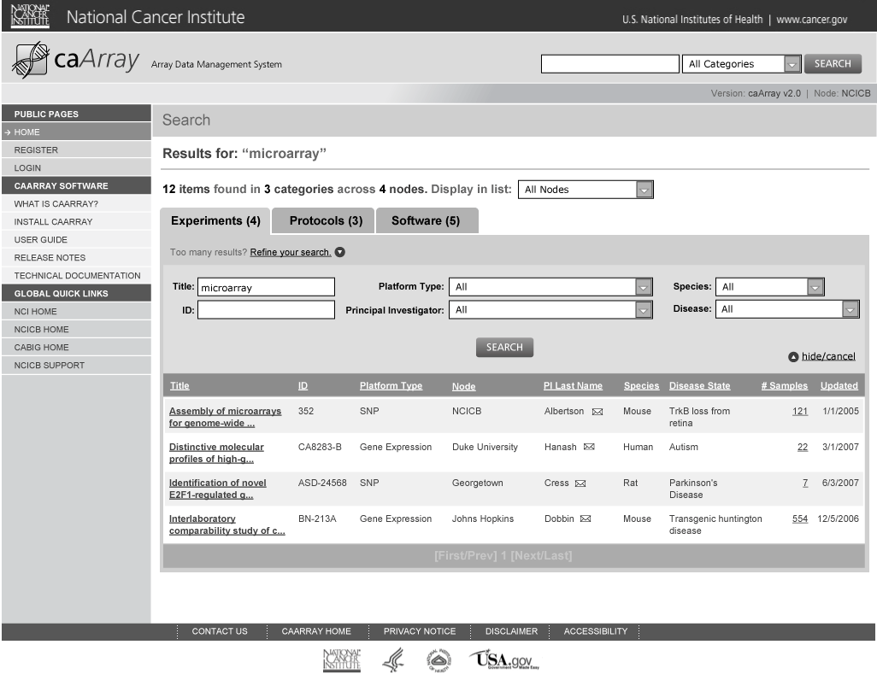
Search and Search Results: Refine Results

Slide 11
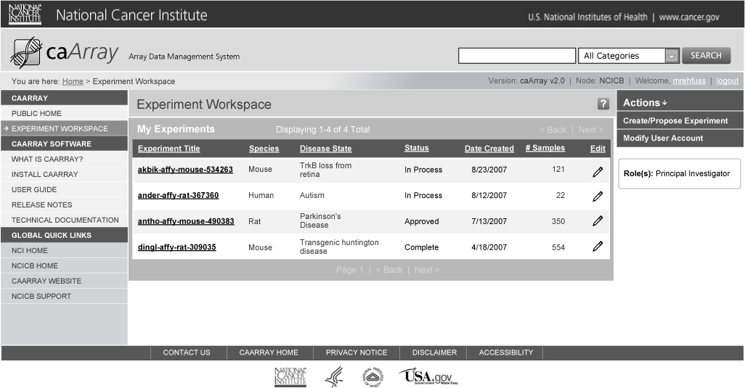
Login

Slide 12
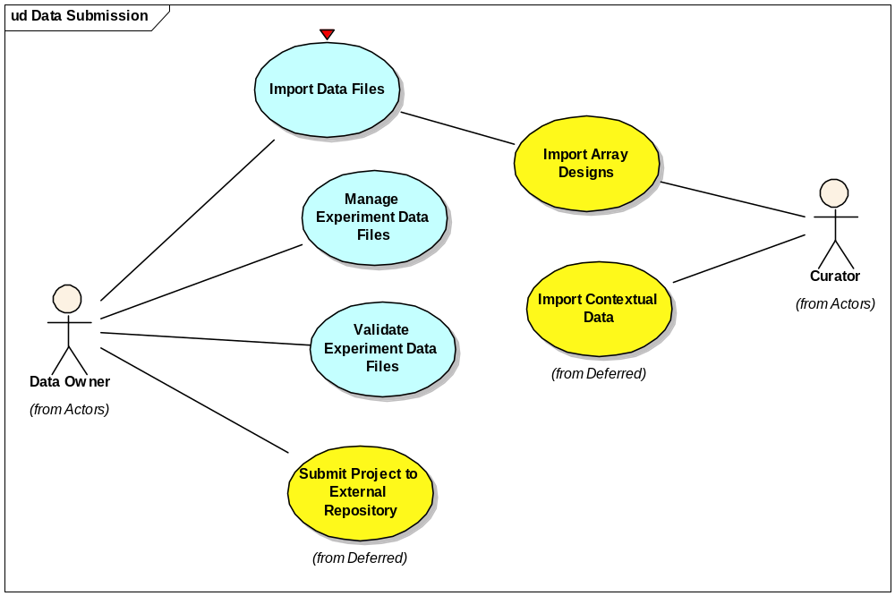
Managing Data

Slide 13
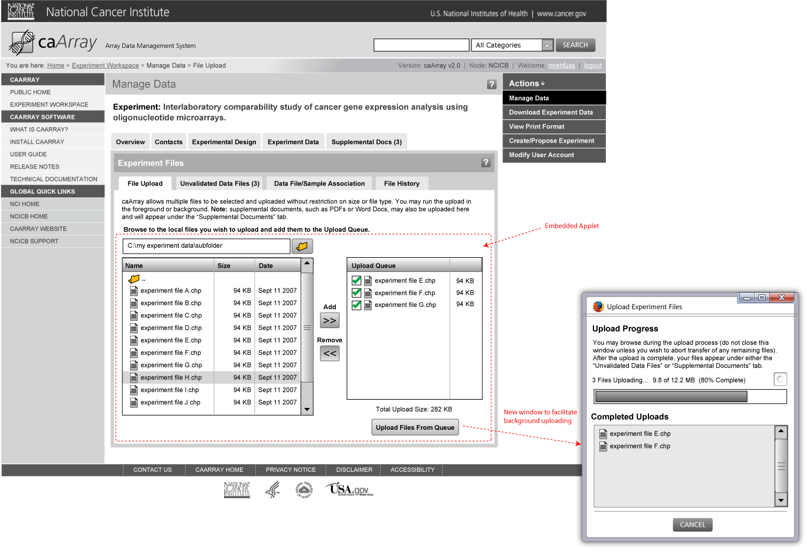
Manage Experiment Data: Upload

Slide 14
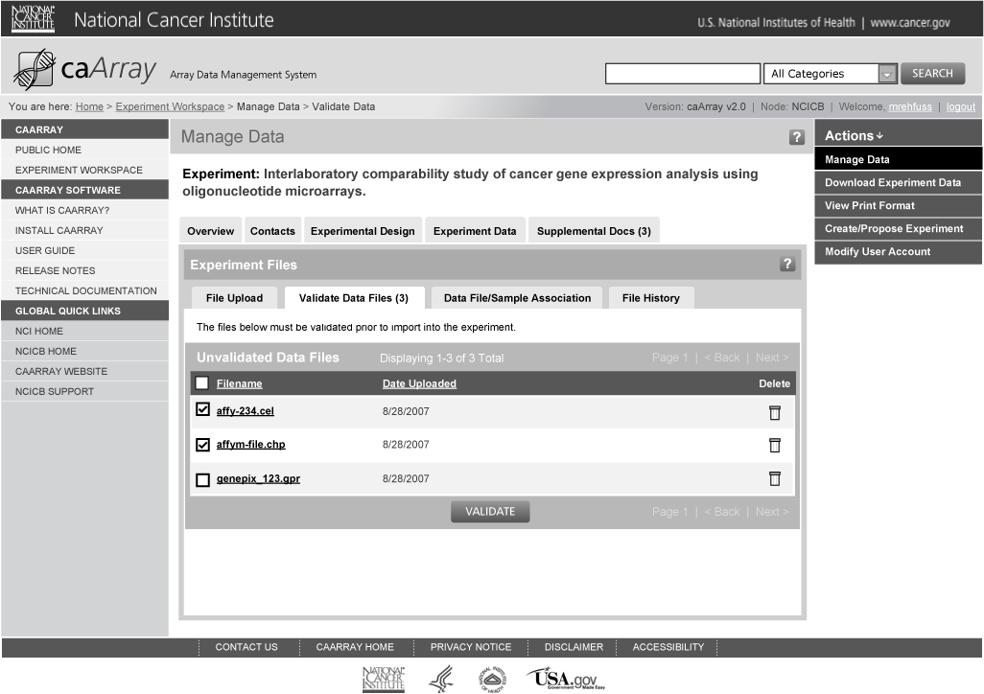
Manage Experiment Data: Import/Validate

Slide 15
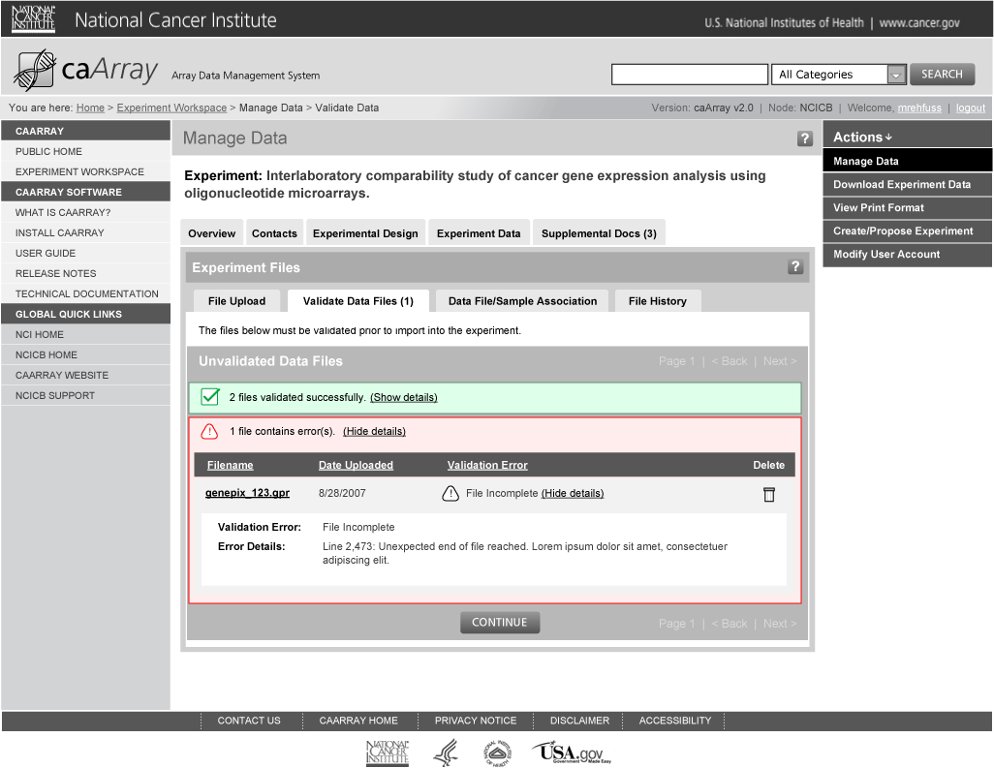
Manage Experiment Data: Import/Validate

Slide 16
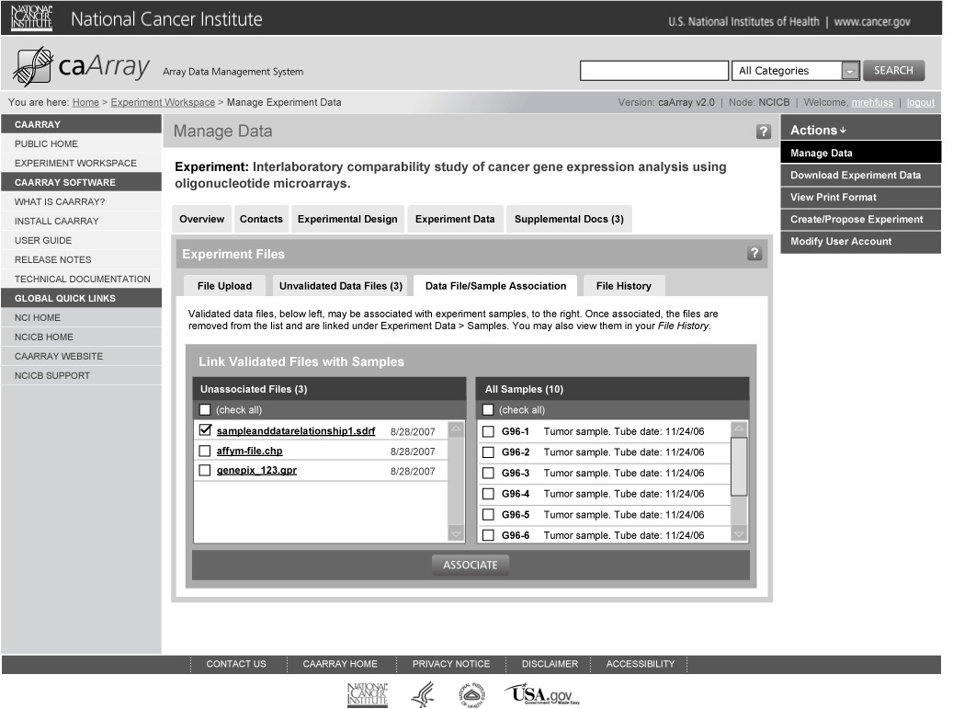
Manage Experiment Data: Link Uploaded Data Files to Samples

Slide 17
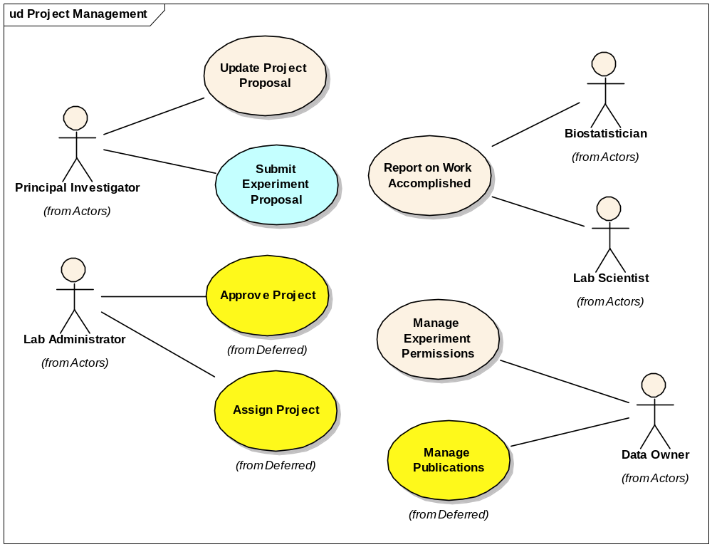
Experiment Management

Slide 18
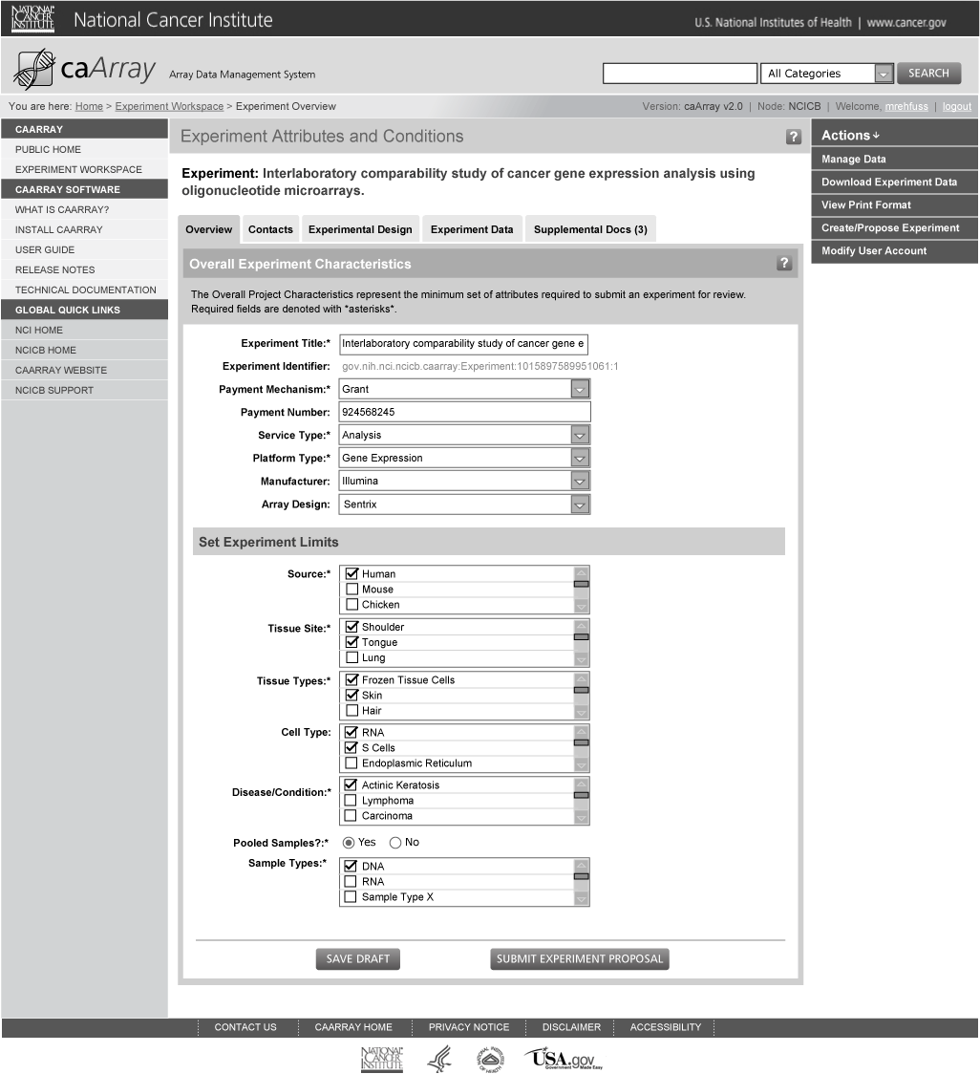
Submit Experiment Proposal: Overview

Slide 19
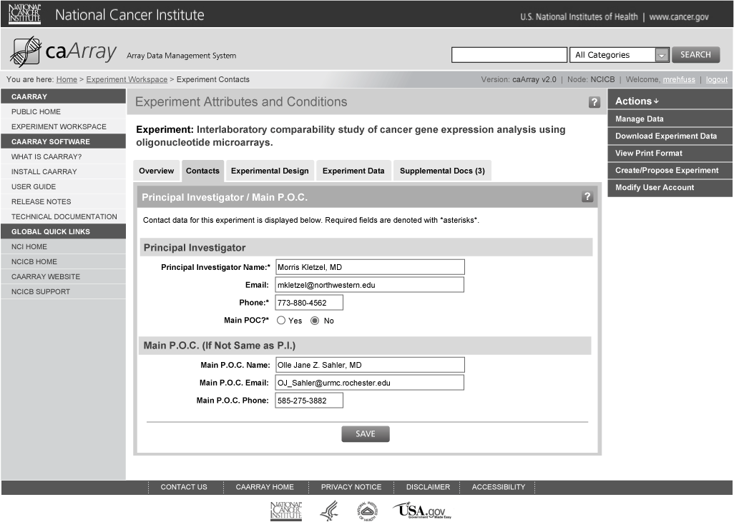
Submit Experiment Proposal: P.I. / Main P.O.C Contact Information

Slide 20
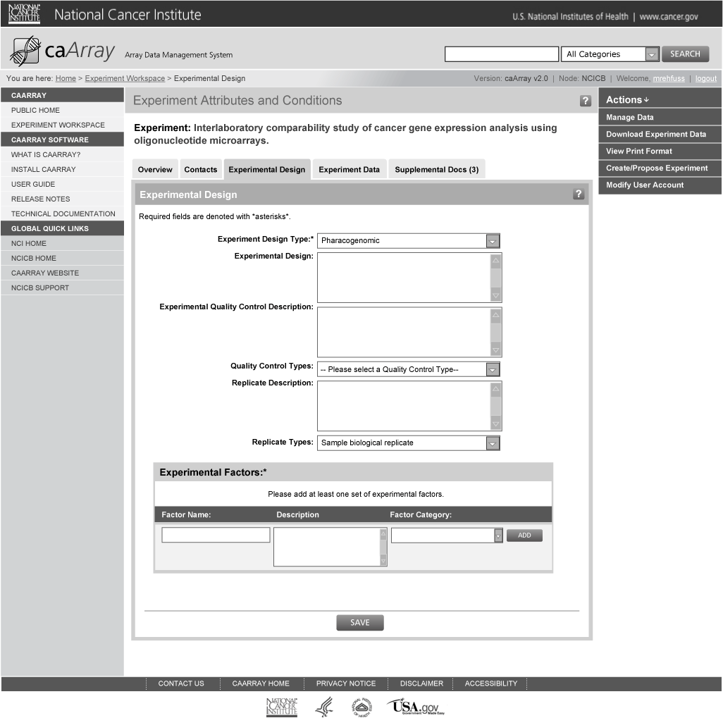
Submit Experiment Proposal: Edit Experimental Design

Slide 21
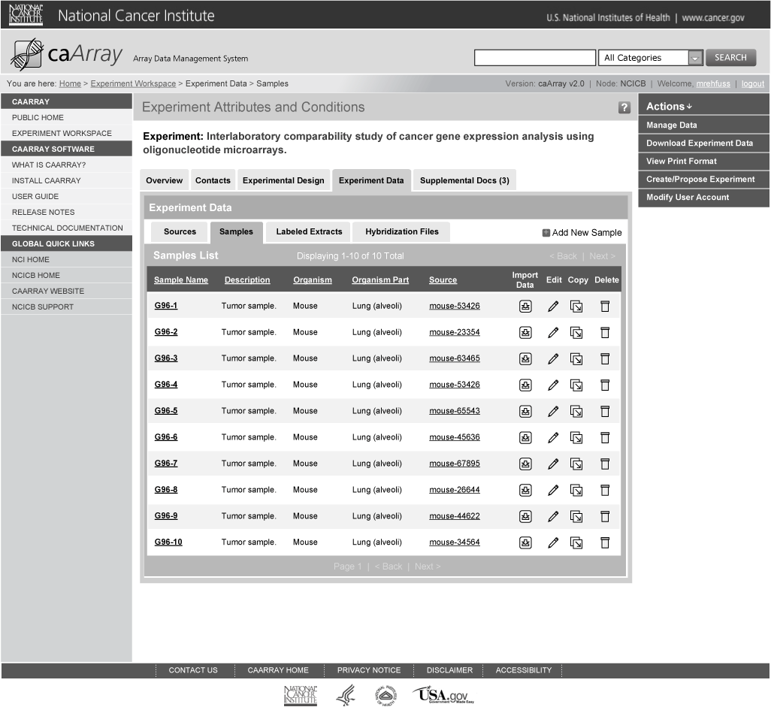
Submit Experiment Proposal: Experiment Data: Samples List

Slide 22
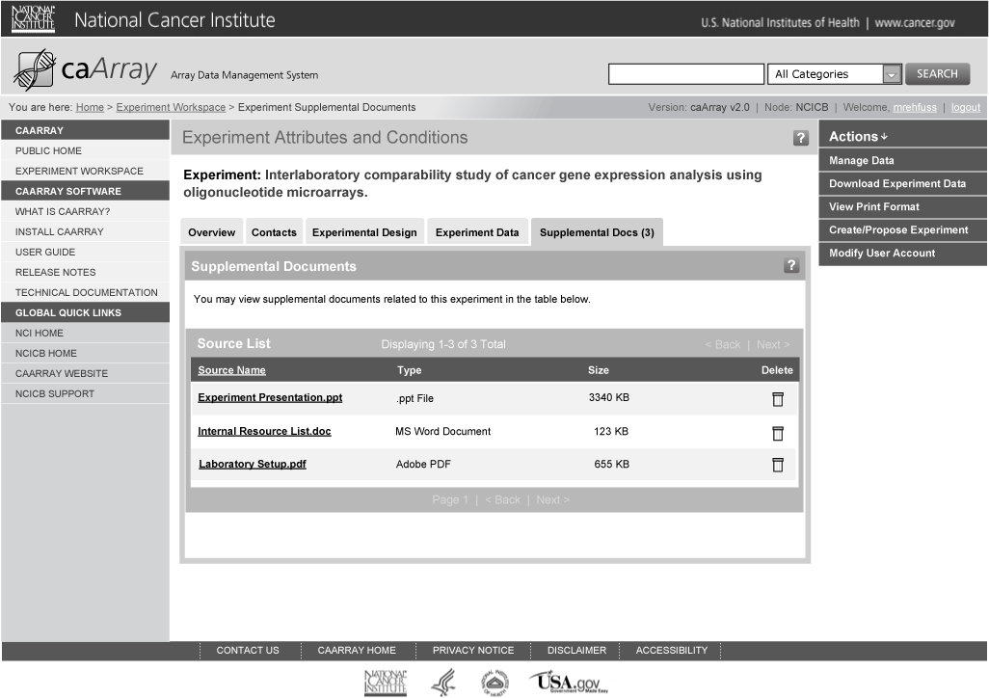
Submit Experiment Proposal: Edit Supplemental Docs

Slide 23
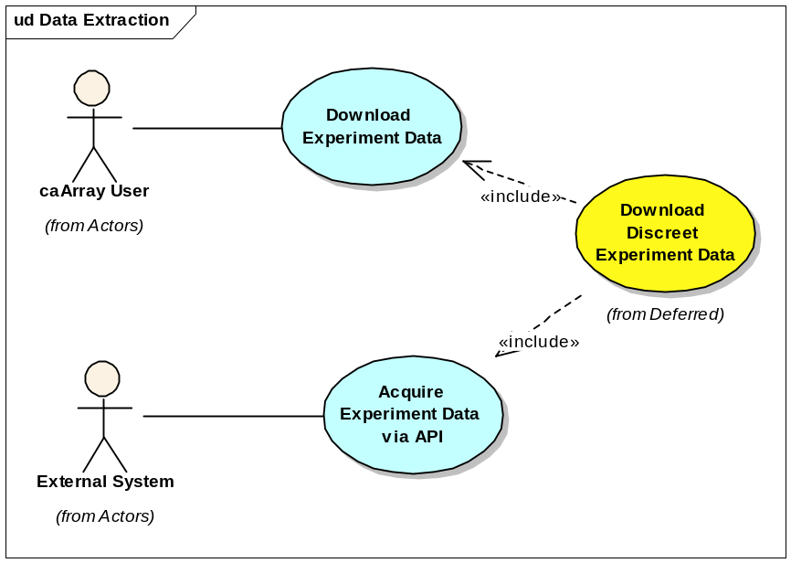
Extraction

Slide 24
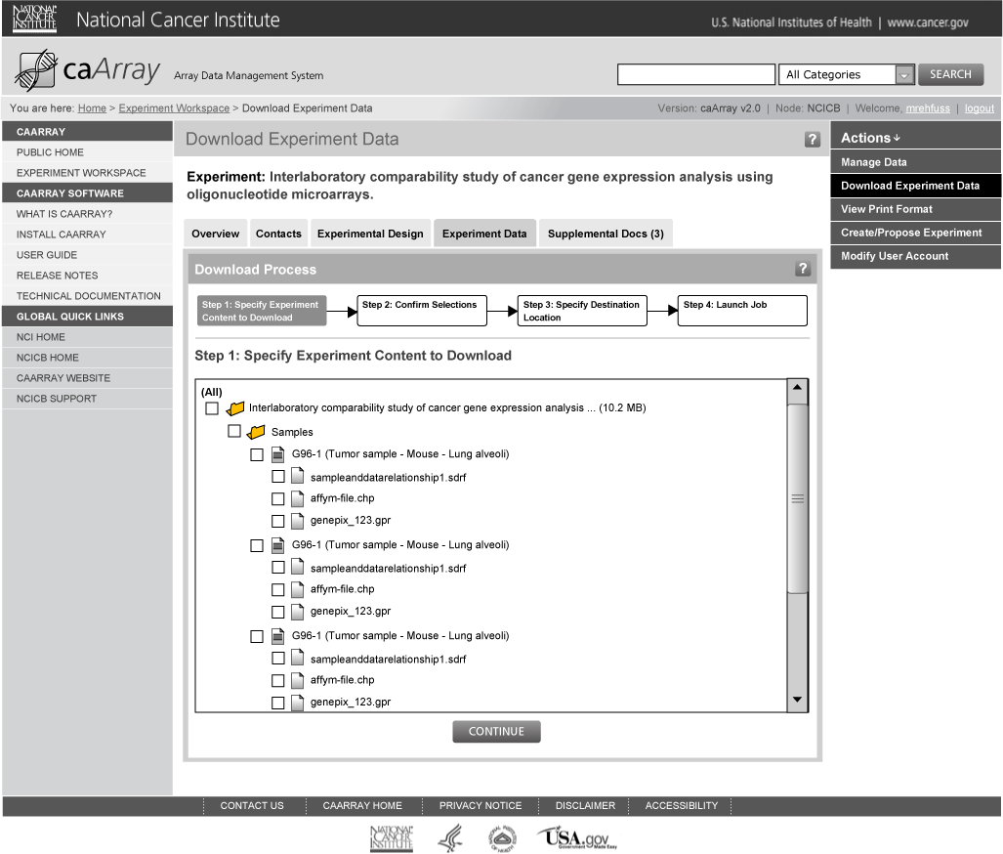
Download Experiment Data: Step 1

Slide 25
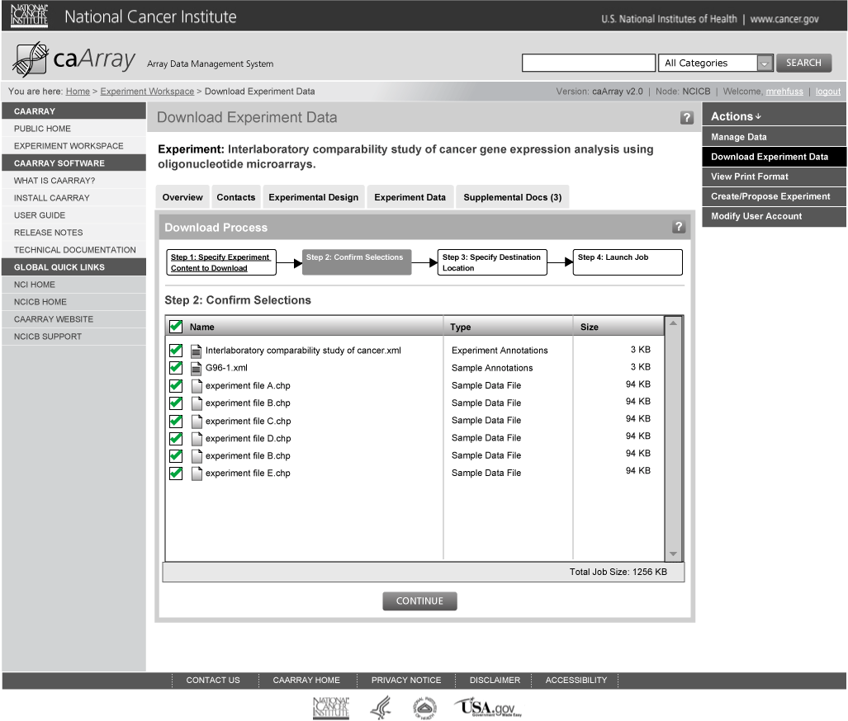
Download Experiment Data: Step 2

Slide 26
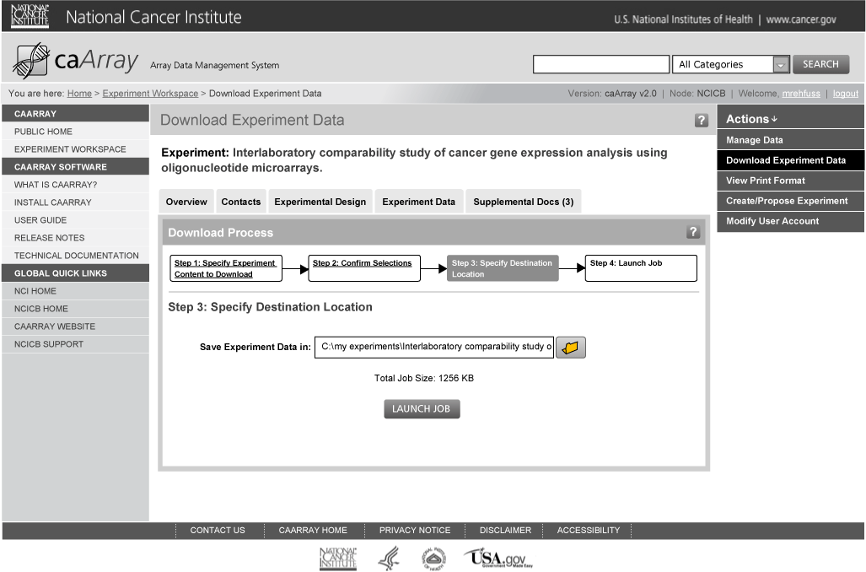
Download Experiment Data: Step 3

Slide 27
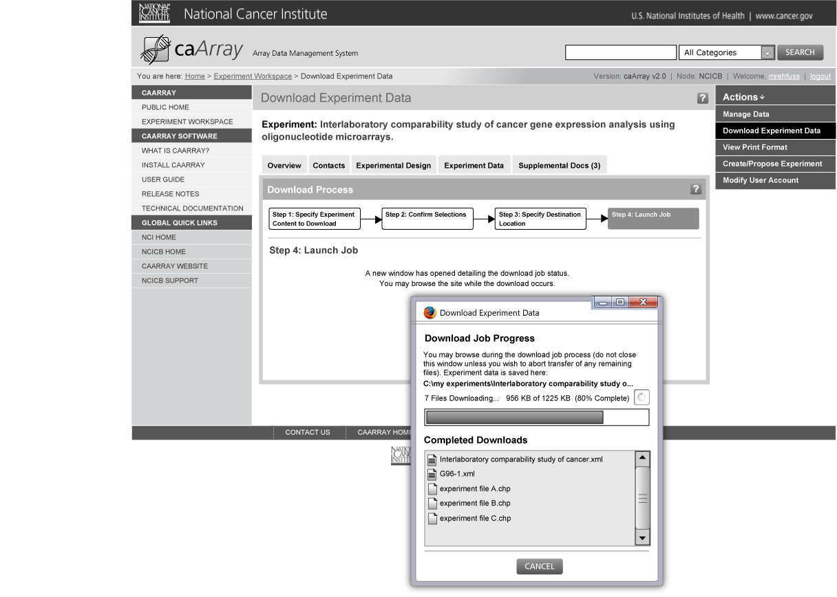
Download Experiment Data: Step 4

